Slide 1
ETL Concepts Part 1
ETL 101 Series
Anupama Putcha
Notes:
Hi, I am Anupama, from the BTS – Datawarehousing practice.
Today I will take you through the ETL concepts Part I module.
The module covers the basics of ETL concepts.
So let us begin our session understanding what ETL is.
The Target Audience are:
Team Rainbow (TRB) associates aligned to Datawarehouse- Business Intelligence practice after Induction training and
Associates who have newly joined Datawarehouse- Business Intelligence practice without prior DWH implementation experience
© 2009 Wipro Ltd – Internal & Restricted
‹#›

Slide 2
ETL Concepts Overview
Data Integration is the process of transforming business data from different applications to provide users with a unified view of data.
Need for Data Integration has increased as the volume and the need to share existing data in disparate sources explodes with mergers, acquisitions, global operations etc.
Extract – Transform – Load (ETL) is the foundation of a Data Integration system.
The ETL details are covered in two parts,
Part 1 – Overview, Data Analysis and Process Flows.
Part 2 – Extraction, Transportation and Loading, and Error Handling

Slide 3
ETL Concepts Objectives
Upon completion of this module you will be able to:
Understand what is a ETL system
Identify different source and target systems
Know different types of DI Process Flows

Slide 4
ETL Concepts Outline
Lesson 1 Overview
Lesson 2 Data Analysis
Lesson 3 Process Flow

Slide 5
Overview
Notes:
This course would have helped you to understand about ETL , Identify different source and target systems and have a fair idea about the different types of DI Process Flows
This completes the 1st part of the module on ETL Concepts.
It is now time to take a small quiz to test your understanding.
GOOD LUCK and THANK YOU

Slide 6
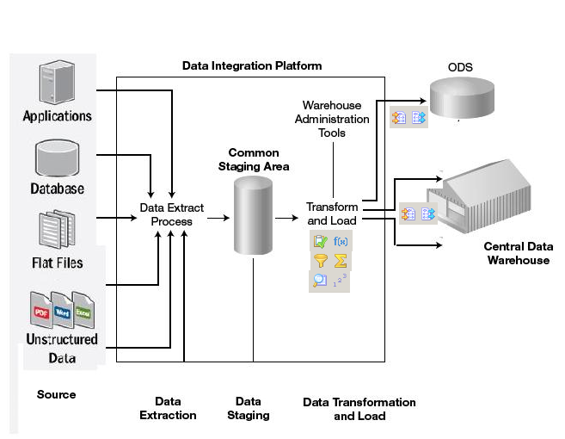
ETL Overview
Extracting data from many disparate, heterogeneous systems
Transforming the data into unified data format
Loading the data into a data warehouse or any other target database / application

Slide 7
Data Processing during ETL
Integrating data
Deriving Data
Filtering data
Aggregating data
Cleansing Data
Validating Data

Slide 8
Data Analysis
Notes:
© 2009 Wipro Ltd – Internal & Restricted
‹#›

Slide 9






Typical Sources
Transactional Data Source
Internal Data Source
Archived Data Source
External Data Source
Common data source formats :

Slide 10
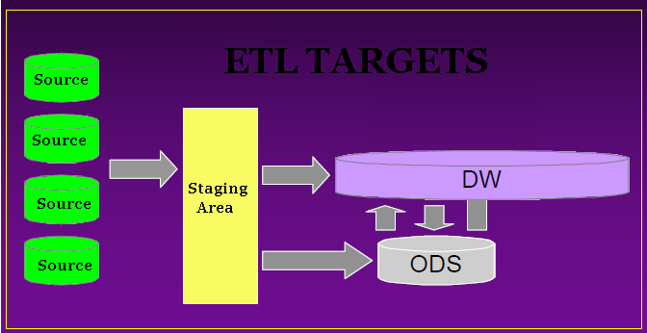
Typical Targets
Staging Area
Operational Data Store (ODS)
Data Warehouse

Slide 11
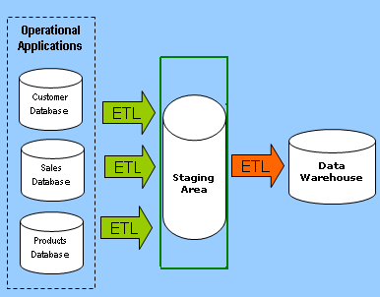
Staging Area
Area where data from multiple sources are pulled and stored before further processing.
Data staging provides a place and an area with a set of functions to
- Clean
- Change
- Combine
- Convert
- Eliminate duplication
- Prepare source data for storage.

Slide 12
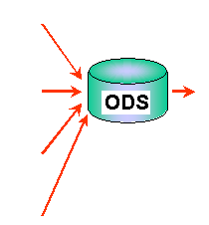
ODS (Operational Data Store)
Designed to Provide integrated, collective information for the operational environment.
Subject-oriented
Integrated
Volatile
Current— no history

Slide 13
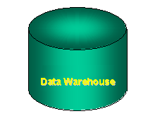
Data Warehouse
A decision support database that is maintained separately from the organisation’s operational database
Support information processing by providing a solid platform of consolidated, historical data for analysis
Subject-oriented
Integrated
Non-volatile (read-only)
Time variant (history).

Slide 14
Data Analysis Aspects
Definition of the data
Data Type
Relationships
Availability
Notes:
© 2009 Wipro Ltd – Internal & Restricted
‹#›

Slide 15
DI Process Flow

Slide 16
DI Process Flow types
TRANSFORM THEN LOAD
LOAD THEN TRANSFORM
TRANSFORM WHILE LOADING

Slide 17
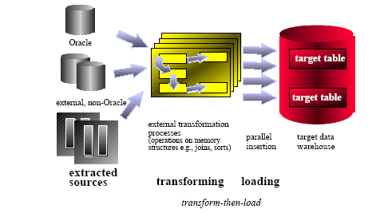
TRANSFORM THEN LOAD
The data is manipulated outside the database to cleanse and sort it, with the result loaded into the database

Slide 18
TRANSFORM THEN LOAD
Risks and Disadvantages
External tools used to prepare the data may not scale as effectively as the database does and will cause a bottleneck.
External mechanism has to control ETL process and provide recovery and restart ability
Database capabilities not fully utilized

Slide 19
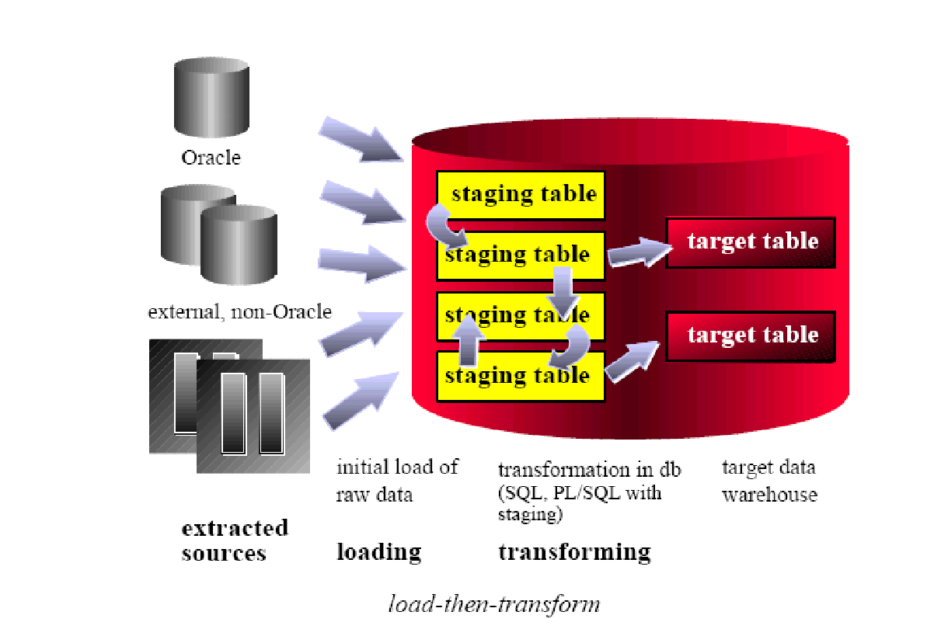
LOAD THEN TRANSFORM
The raw data from the source system is copied into staging tables in the database, where it is cleansed and then loaded into the warehouse tables.

Slide 20
LOAD THEN TRANSFORM
Risks and disadvantages
Extra disk storage for the staging tables is required. Original raw data from the source systems as well as intermediate data needs to be stored in the Database.
Database Routines might not be optimized to handle all ETL issues easily.

Slide 21
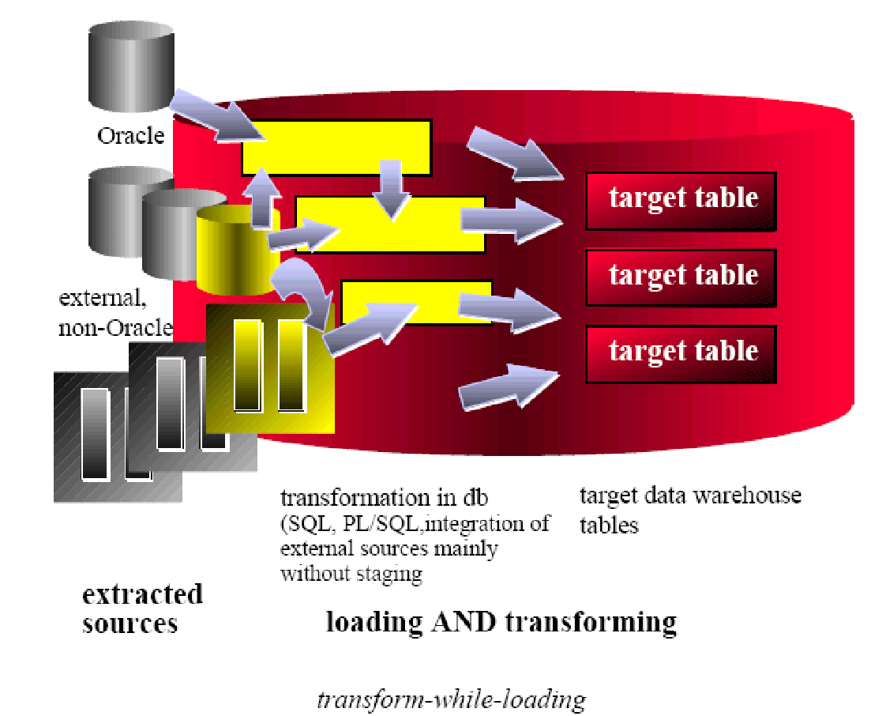
TRANSFORM WHILE LOADING
The raw data is selected directly from a stream of data from the production system or flat files, transformed by applying one or more table functions to it, and then written to the database

Slide 22
Module Summary
Congratulations! You have now completed first part the module ETL Concepts
You should now be able to
Understand what is a ETL system
Identify different source and target systems
Know different types of DI Process Flows

Slide 23
Quiz

Slide 24
Question 1
Which of the following can not perform during the ETL process.
Filtering
Reporting
Aggregating
Cleansing

Slide 25
Question 1
Which of the following can not perform during the ETL process.
Filtering
Reporting
Aggregating
Cleansing
Answer : B

Slide 26
Question 2
2. In “Load then Transform” the data transformation happens in ETL Engine ?
True
False
Notes:
© 2009 Wipro Ltd – Internal & Restricted
‹#›

Slide 27
Question 2
2. In “Load then Transform” the data transformation happens in ETL Engine ?
True
False
Answer B
Notes:
© 2009 Wipro Ltd – Internal & Restricted
‹#›

Slide 28
Question 3
3. Which of the following does not describes the ETL data flow.
TRANSFORM THEN LOAD
LOAD THEN TRANSFORM
TRANSFORM WHILE LOADING
TRANSFORM WHILE EXTRACTING
Notes:
© 2009 Wipro Ltd – Internal & Restricted
‹#›

Slide 29
Question 3
3. Which of the following does not describes the ETL data flow.
TRANSFORM THEN LOAD
LOAD THEN TRANSFORM
TRANSFORM WHILE LOADING
TRANSFORM WHILE EXTRACTING
Answer D

Slide 30
Question 4
4. Which statement below is incorrect.
ODS has current data
Data warehouse has historic data
Updates are commonly done on ODS
Updates are common done on Data warehouse

Slide 31
Question 4
4. Which statement below is incorrect.
ODS has current data
Data warehouse has historic data
Updates are commonly done on ODS
Updates are common done on Data warehouse
Answer D

Slide 32
Question 5
5. What does ODS stand for ?
Outside data store
Operational data store
Optional data store
Organization data store

Slide 33
Question 5
5. What does ODS stand for ?
Outside data store
Operational data store
Optional data store
Organization data store
Answer B

Slide 34
References

Slide 35
References
Publications
Courses
ETL toolkit – by Ralph Kimball
<List additional courses in your
curriculum which learners can take>
URL’s
Training Programs
http://www.tdwi.org
http://download.oracle.com/docs/cd/B28359_01/server.111/b28313/toc.htm
<List additional training programs related
to the curriculum which learners can
attend>

Slide 36
Thank You
Anupama Putcha
anupama.putcha@wipro.com

